Slide 1

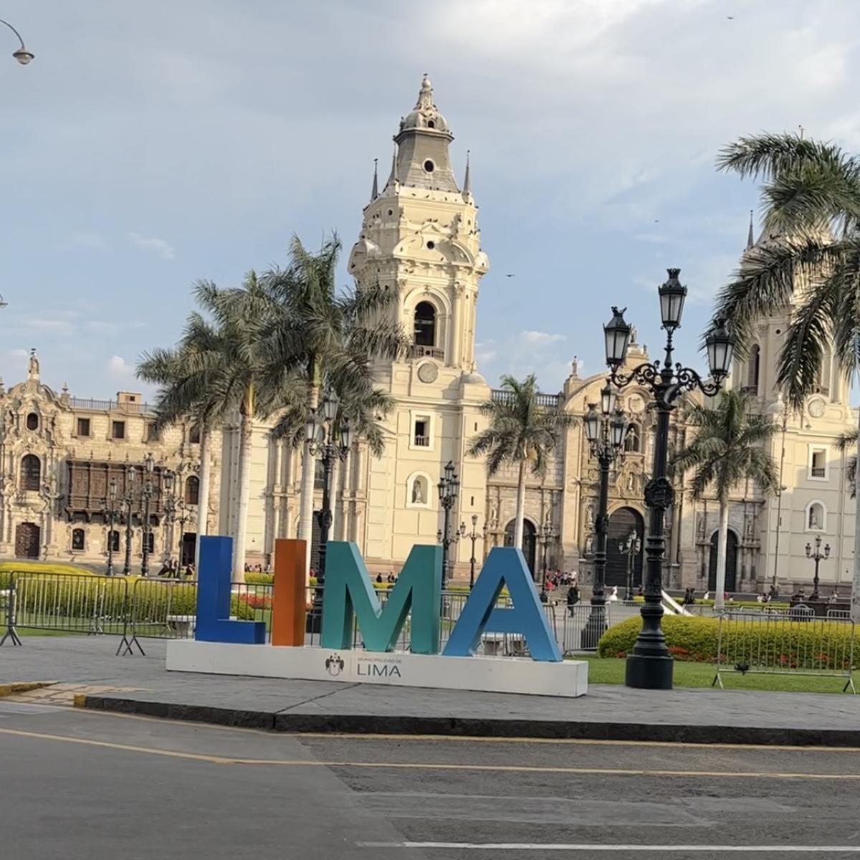
Henry Diaz
SIUU

Slide 2
Favorite Artists

Slide 3


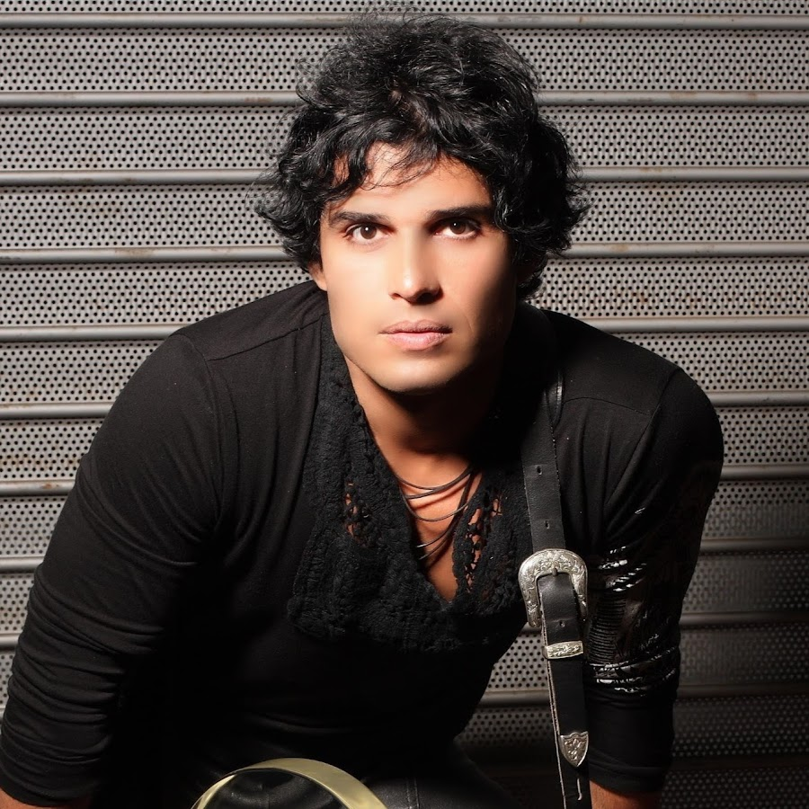




Pedro Suárez Vertiz

Slide 4
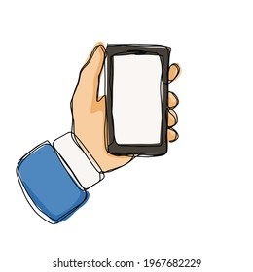
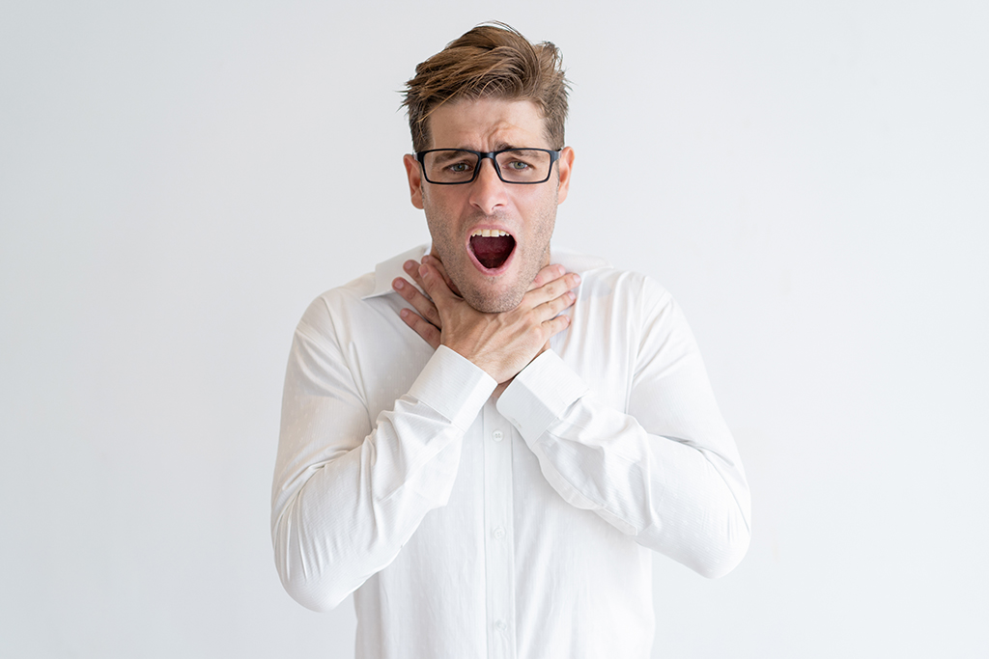
Favorite item

Slide 5
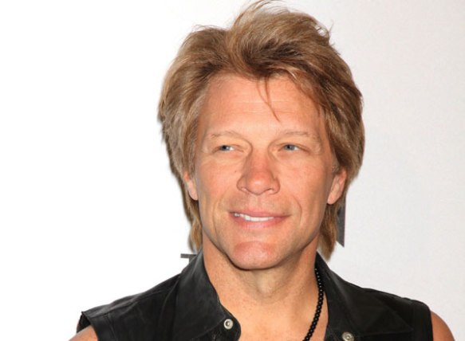
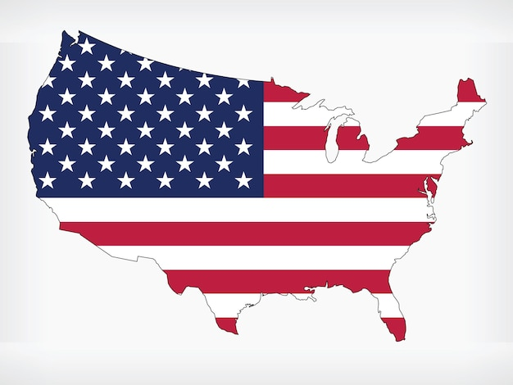


John Francis Bongiovi
Bon Jovi

Slide 6


Favorite item

